Slide 1
Lecture 7: Intro to Python & Pair Programming
CSC111: Introduction to CS through Programming
R. Jordan Crouser
Assistant Professor of Computer Science
Smith College

Slide 2
Announcements
Note Taker: paid position available
Requirements: on work study, 1.5hr week
What you’ll do: take clear, concise notes for this course and deliver them to the Office of Disability Services
If interested: email Lisa Roberge in ODS at lroberge@smith.edu (subject: Note Taker for CSC111-01 / R. Jordan Crouser)

Slide 3
Overview of the week
Crash course in computers
A little history
4 key components
Quick hardware demo
Boolean logic
Introduction to Python
Life skill #1: pair programming
Lab: Getting Started with Python
User Input

Slide 4

Recap
What do you remember
from Monday’s class?

Slide 5
Recap: the good news
“High level” programming languages like Python mean we don’t have to write in “low level” binary
Instead, we write statements like:
print(“hello”)
Notes:
However, it’s useful to understand that for all the things we ask of our machines at a high level, at this level (show hardware), everything we do is just operations on 0s and 1s.

Slide 7
What do you know?

Slide 8
multi-paradigm
interpreted language
with dynamic typing
and automatic memory management

Slide 9
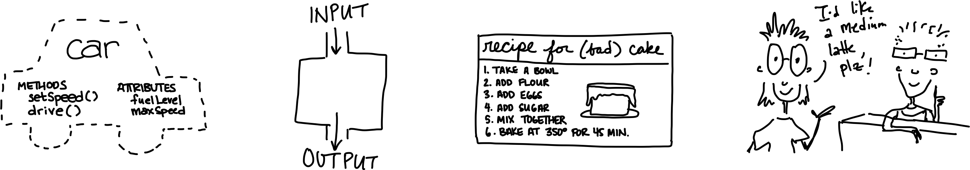
multi-paradigm
interpreted language
with dynamic typing
and automatic memory management
object-oriented
functional
imperative
declarative

Slide 10
multi-paradigm
interpreted language
with dynamic typing
and automatic memory management

Slide 11
Quick digression
 | COMPILER | INTERPRETER
What it takes in:
What it returns:
Relative speed:
Memory usage:
Work is done:
Reports errors:
Example language:

Slide 12
Quick digression
 | COMPILER | INTERPRETER
What it takes in: | an entire program | a single line of code (or a single instruction)
What it returns: | intermediate object code (e.g. classes) | <nothing>
Relative speed: | faster | slower
Memory usage: | uses more memory (↑ objects take space ↑) | uses less memory (no intermediate objects)
Work is done: | just once | every time the code is executed
Reports errors: | after checking the entire program | after each instruction is run

Slide 13
multi-paradigm
interpreted language
with dynamic typing
and automatic memory management
more about this
a bit later

Slide 14
Core concept 1: variables
In CS, a variable is a place to store a piece of data
In Python, variables are:
declared by giving them a name
assigned using the equals sign
Example:
x = 3
declaring
a variable x
assigning
the value 3 to x

Slide 15
Core concept 2: numeric values
Two kinds of numbers in CS:
integers (“whole numbers”)
floats (“decimals” or “floating point numbers”)
In Python, the kind of number is implied by whether or not the number contains a decimal point
Example:
x = 3
x = 3.0

Slide 16
Basic operations on numbers
Addition: +
Subtraction: -
Multiplication: *
Division: /
Exponentiation: ** (power)
Modular arithmetic: % (modulo)

Slide 17
Core concept 3: strings
In CS, a sequence of characters that isn’t a number is called a string
In Python, a string is declared using quotation marks
Strings can contain letters, numbers, spaces, and special characters
Example:
x = “Jordan”
x = “Stoddard G2”

Slide 18
Math on strings?!
Let’s say we have:
x = “Jordan”
If we ask Python for:
2*x
what will happen?

Slide 19
print(): a very useful function
A function is a procedure / routine that takes in some input and does something with it (just like in math)
In Python, the print() function takes in a value and outputs the value to the console
This seems silly now, but will come in handy in lab when you write/run your first program inside a file

Slide 20
Quick check in
a = 1
b = 2.7
c = “Smithies”

Slide 21
Overview of the week
Crash course in computers
A little history
4 key components
Quick hardware demo
Boolean logic
Introduction to Python
Life skill #1: pair programming
Lab: Getting Started with Python
User Input

Slide 22
The programming process

Slide 23
The programming process (idealized)

Slide 24
The programming process (idealized)

Slide 25
The programming process (idealized)

Slide 26
The programming process (idealized)

Slide 27
The programming process (idealized)

Slide 28
The programming process (more realistic)

Slide 29
Getting started

Slide 30
“S⁴”: start small | slow | simple

Slide 31
Next: address the constraints

Slide 32
Add additional features

Slide 33
Finally: hit target

Slide 34
Discussion
So what does this
look like in practice?

Slide 35
A problematic (but common) model

Slide 36
A better model: “pair programming”
two
people
one
machine

Slide 37
Two complimentary roles
driver
navigator

Slide 38
A common analogy
driver
navigator

Slide 39
Navigator vs. driver: different focus
“what”
“how”
“why”

Slide 40
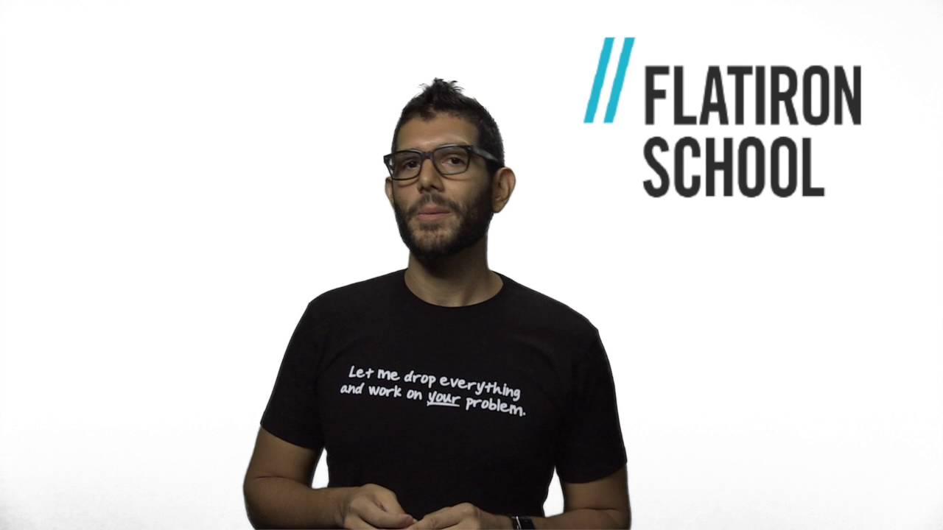
A professional perspective (& some tips)

Slide 41
Reality check
What makes this approach
so hard?

Slide 43
Overview of the week
Crash course in computers
A little history
4 key components
Quick hardware demo
Boolean logic
Introduction to Python
Life skill #1: pair programming
Lab: Getting Started with Python
User Input

Slide 44
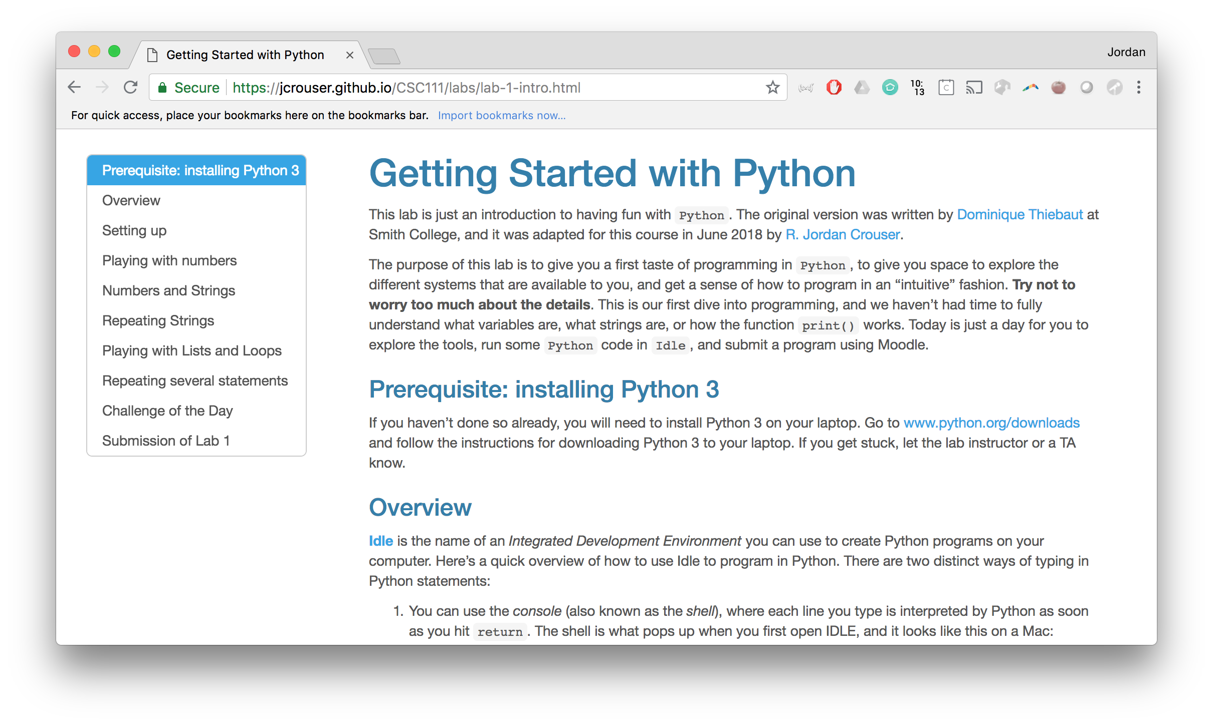
Your first taste of pair programming!

